Slide 1
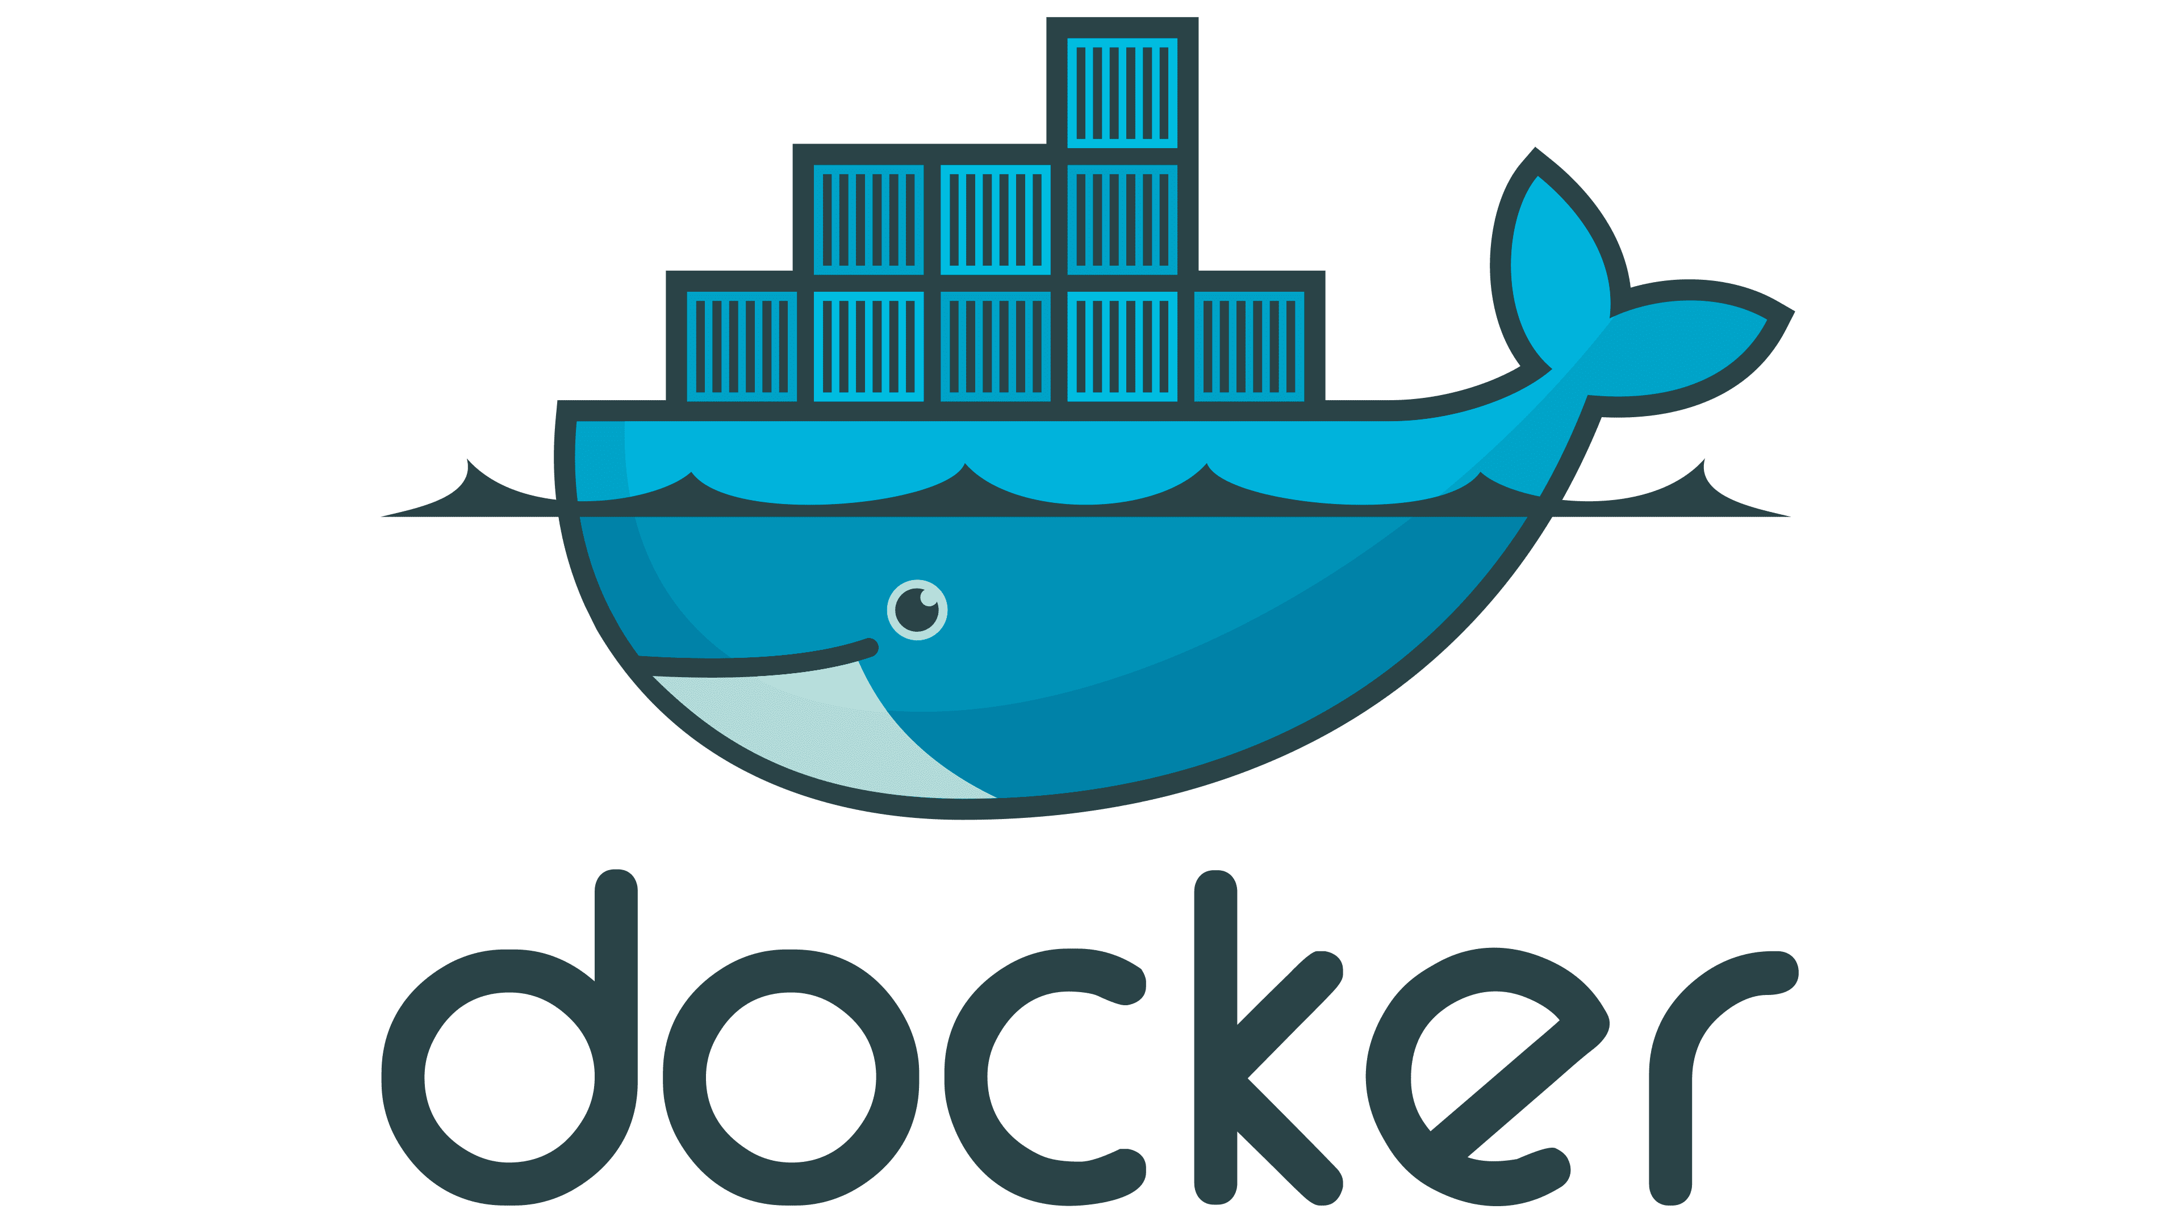
Masterclass

Slide 2
Agenda
Docker architecture
Setting up Docker
Docker images
Docker containers
Creating Docker images
Docker Compose
Docker Engine API

Slide 3
What is not on the agenda?
How to run containers in production
How to run containers in distributed environment
How to do container orchestration
How to publish images
How to work with containers in the cloud

Slide 4
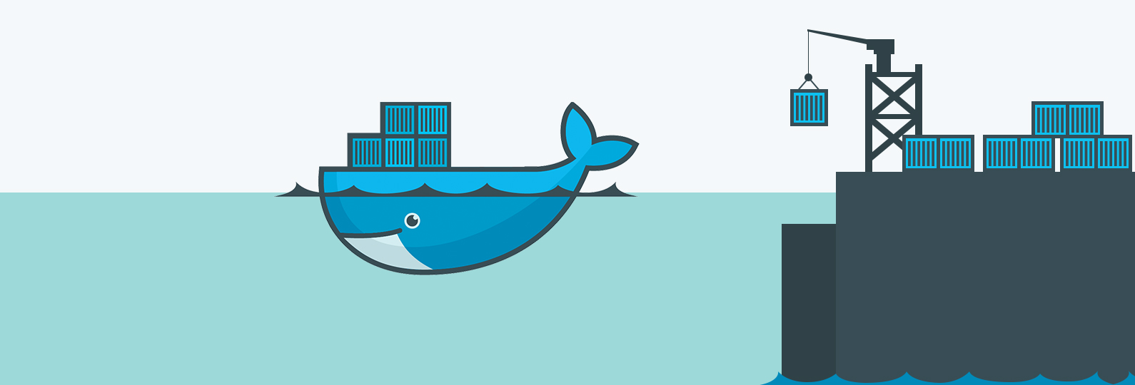
Docker Architecture

Slide 5
Virtual Machines vs. Containers
VM 1
VM
App 1
App 2
App 3
Container 1
Container 2
Container 3
Bins / Libs
Bins / Libs
Bins / Libs
App 1
App 2
App 3
Guest OS
Guest OS
Guest OS
Bins / Libs
Bins / Libs
Bins / Libs
Hypervisor
Docker Engine
Host OS
Host OS
Hardware
Hardware

Slide 6
Docker architecture
Docker Client
Docker Host
Docker Image registry
Docker Engine REST API Client
Docker Daemon
Docker Image Registry Server
Docker CLI
Docker Engine REST API
Docker Engine
Images
Image 1
Docker Desktop
Containers
Images
Image 2
Container 1
Image 1
Image 3
Docker Compose
App 1
Image 2
Image 4
Docker.DotNet
Image 3
Image 5
Container 2
Image 4
Image 6
Kubernetes
App 2
Image 7
Image 8

Slide 7
Docker architecture
Docker Client
Docker Host
Docker Image registry
Docker Engine REST API Client
Docker Daemon
Docker Image Registry Server
Docker CLI
Docker Engine REST API
Docker Engine
Images
Image 1
Docker Desktop
Containers
Images
Image 2
Container 1
Image 1
Image 3
Docker Compose
App 1
Image 2
Image 4
Docker.DotNet
Image 3
Image 5
Container 2
Image 4
Image 6
Kubernetes
App 2
Image 7
Image 8

Slide 8
Docker architecture
Docker Client
Docker Host
Docker Image registry
Docker Engine REST API Client
Docker Daemon
Docker Image Registry Server
Docker CLI
Docker Engine REST API
Docker Engine
Images
Image 1
Docker Desktop
Containers
Images
Image 2
Container 1
Image 1
Image 3
Docker Compose
App 1
Image 2
Image 4
Docker.DotNet
Image 3
Image 5
Container 2
Image 4
Image 6
Kubernetes
App 2
Image 7
Image 8

Slide 9
Docker architecture
Docker Client
Docker Host
Docker Image registry
Docker Engine REST API Client
Docker Daemon
Docker Image Registry Server
Docker CLI
Docker Engine REST API
Docker Engine
Images
Image 1
Docker Desktop
Containers
Images
Image 2
Container 1
Image 1
Image 3
Docker Compose
App 1
Image 2
Image 4
Docker.DotNet
Image 3
Image 5
Container 2
Image 4
Image 6
Kubernetes
App 2
Image 7
Image 8

Slide 10
Docker Engine architecture
Docker Engine
Linux Kernel
(cgroups, namespaces, …)
CPU
Memory
Storage
Network

Slide 11
Docker Engine responsibilities
Process management and isolation
Network access management
File system access management

Slide 12
Developing with Docker
Simple development environment setup
Build once, run anywhere
Works on my machine

Slide 13
Setting up Docker

Slide 14
On Linux
> sudo apt-get install docker-ce docker-ce-cli containerd.io docker-compose-plugin
Reference:
https://docs.docker.com/engine/install/

Slide 15
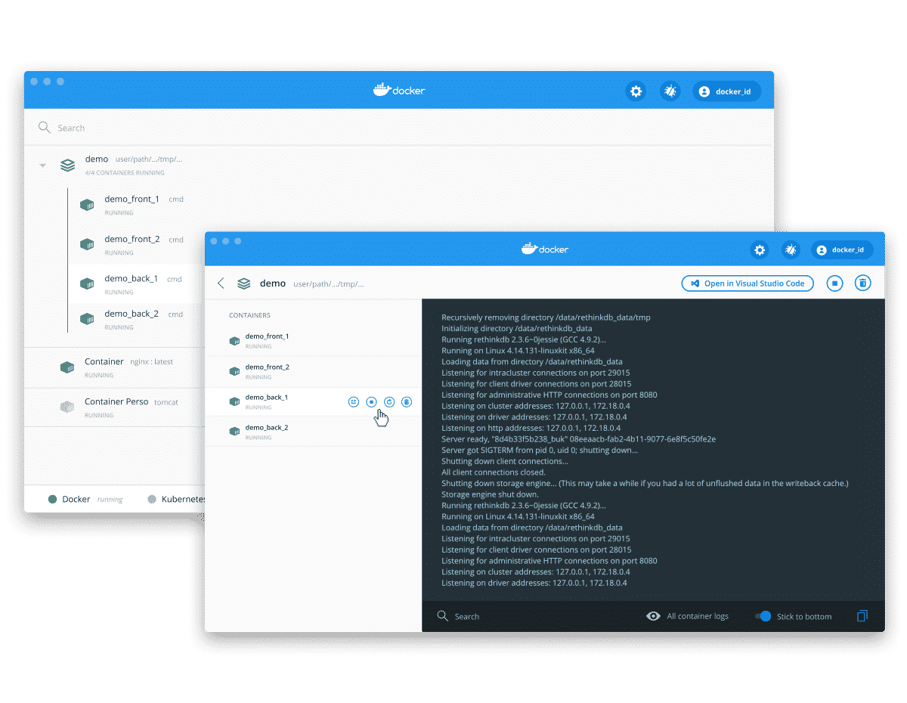
Docker Desktop (for Windows/Mac/Linux)
Includes:
Docker Engine
Docker CLI
Docker Compose
Docker Dashboard
Reference:
https://docs.docker.com/desktop/

Slide 16
Docker Images

Slide 17
Docker architecture
Docker Client
Docker Host
Docker Image registry
Docker Engine REST API Client
Docker Daemon
Docker Image Registry Server
Docker CLI
Docker Engine REST API
Docker Engine
Images
Image 1
Docker Desktop
Containers
Images
Image 2
Container 1
Image 1
Image 3
Docker Compose
App 1
Image 2
Image 4
Docker.DotNet
Image 3
Image 5
Container 2
Image 4
Image 6
App 2
Kubernetes
Image 7
Image 8

Slide 18
Docker images
Docker image is a template for a container.
Docker image is composed of layers defined in Dockerfile:
a base layer (the environment) and
one or more layers that contain:
Runtime (optional) and
Application files (executables, binaries, configuration files, assets, …).
Docker image is immutable once built.
Docker image can be built on top of other docker images.
Docker image defines application entry point.
Docker image is built per platform (amd64, arm32, …)
Docker images can be tagged and versioned.

Slide 19
Docker image lifecycle
Docker image is built by the author.
Docker image is pushed (to image registry) or exported (to the file system) by the author.
Docker image is pulled or imported by the consumer.
Docker image is removed by the consumer.

Slide 20
Docker image lifecycle
Author Docker engine
Docker image registry
Consumer Docker engine
Image 1
push
Image 2
pull
Artifacts
Image
Image 3
Image
Base image
Original
Copy
build
File system
Dockerfile
rm
Image 1.tgz
rm
Removed
export
Image 2 .tgz
import
Removed
Application artifacts
Image 3 .tgz

Slide 21
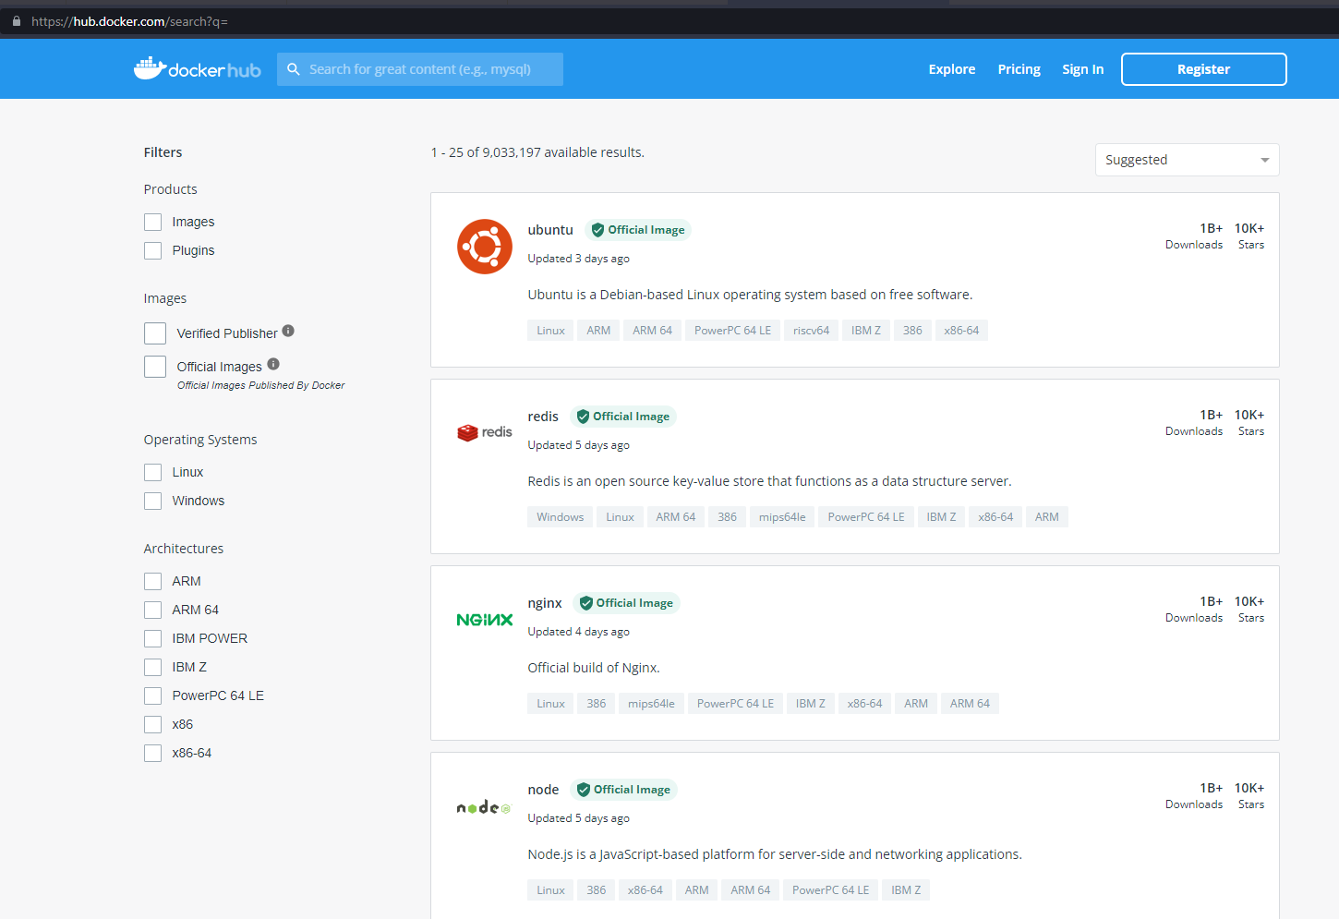
Docker image registry

Slide 22
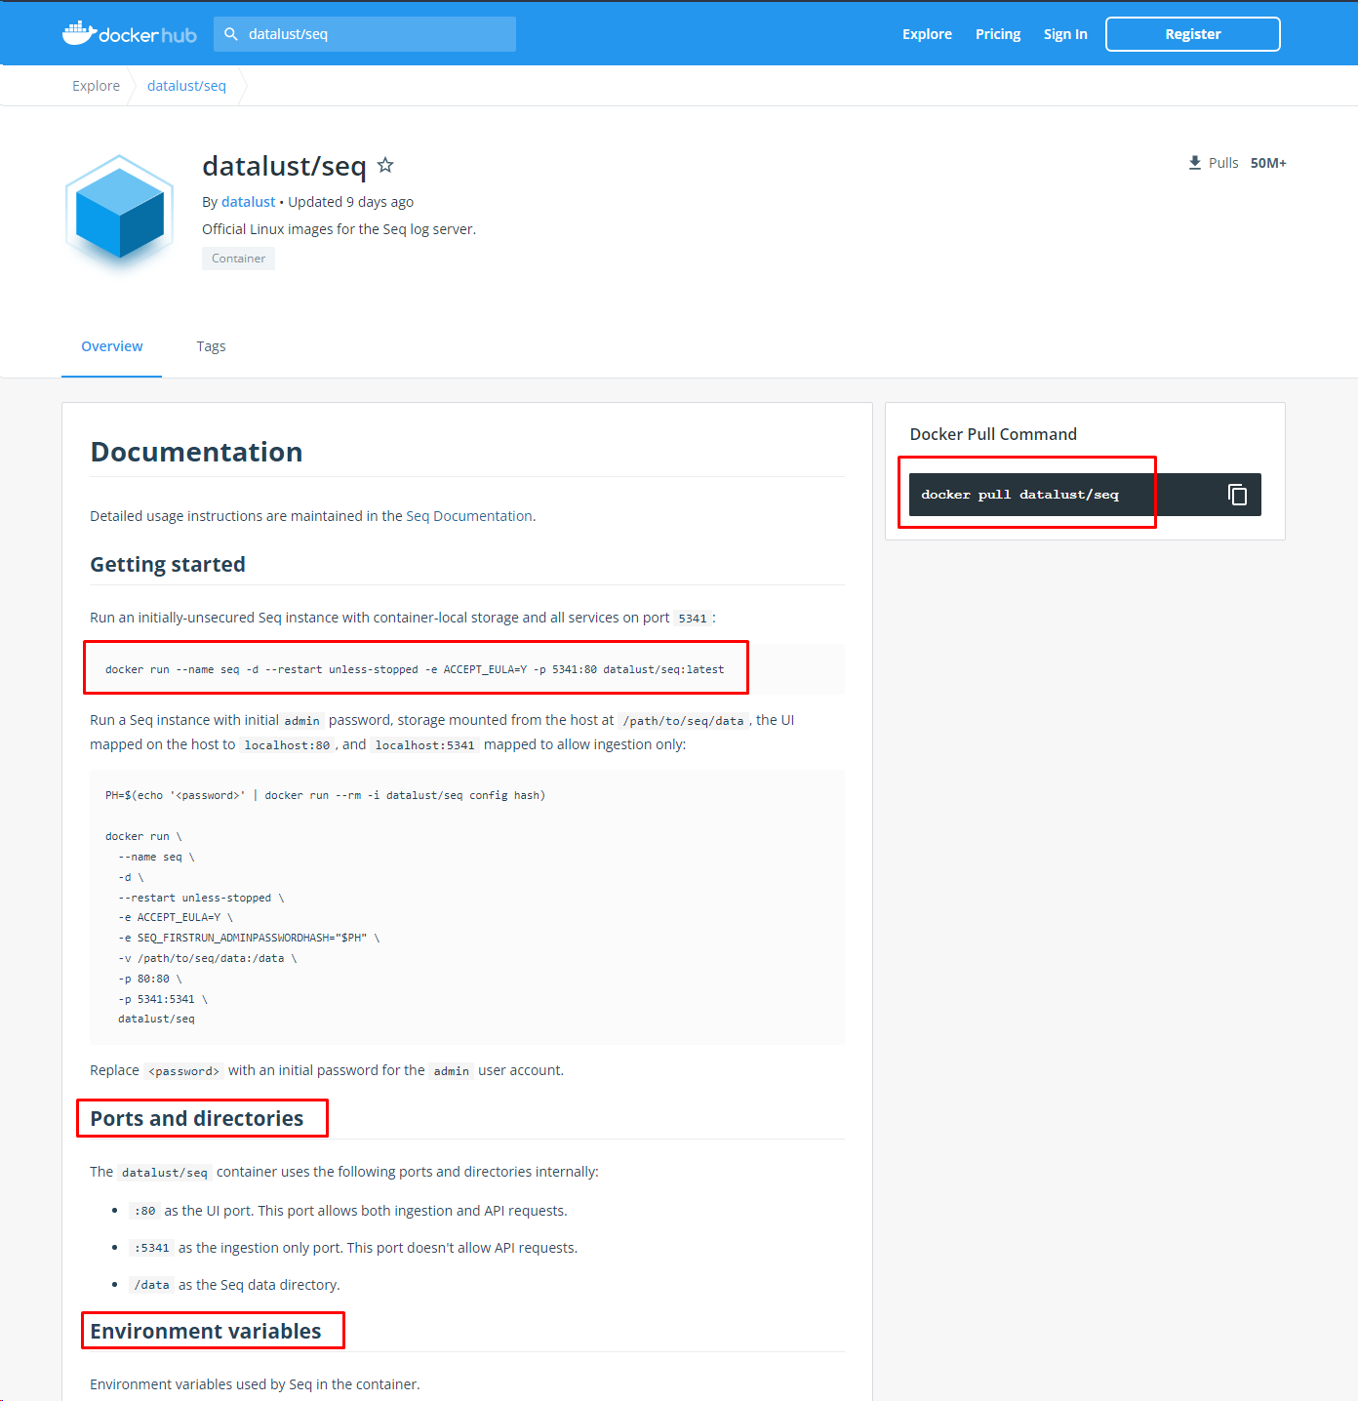
Docker image registry

Slide 23
Listing Docker images
> docker image ls [OPTIONS] [REPOSITORY[:TAG]]
Common options:
--quiet (only show image ID)
Reference:
https://docs.docker.com/engine/reference/commandline/image_ls/

Slide 24
Pulling a Docker image
> docker image pull [OPTIONS] NAME[:TAG|DIGEST]
Reference:
https://docs.docker.com/engine/reference/commandline/image_pull/

Slide 25
Removing a Docker image
> docker image rm [OPTIONS] IMAGE [IMAGE...]
Note:
Any running containers must be stopped/removed before an image can be removed.
Only images that have no containers can be removed (using --force flag will remove an image with non-running containers).
Common options:
-- force (removes any non-running containers based on this image)
Reference:
https://docs.docker.com/engine/reference/commandline/image_rm/

Slide 26
Removing all Docker images
> docker image rm -f $(docker image ls -aq)
Reference:
https://docs.docker.com/engine/reference/commandline/image_rmi/

Slide 27
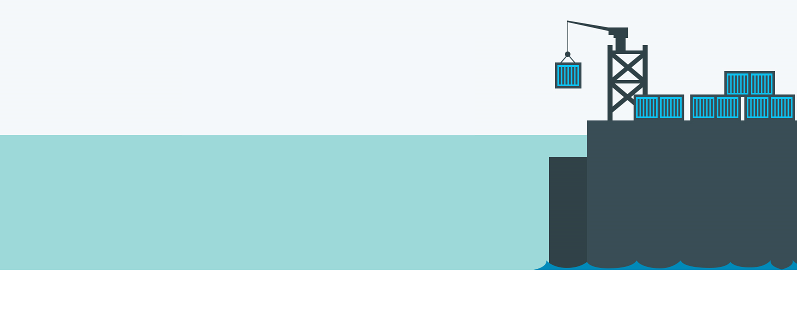
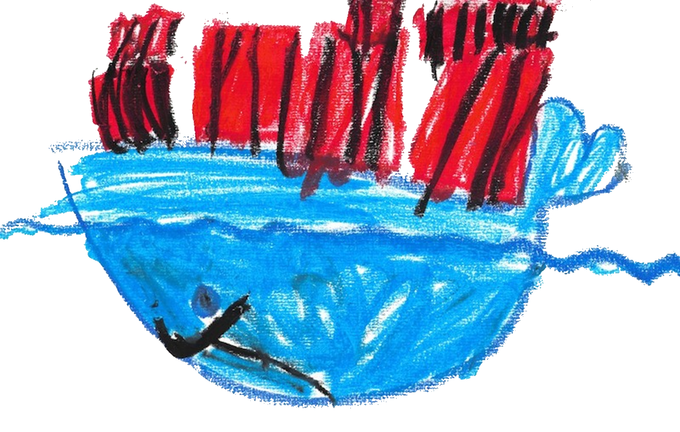
DEMO Working with Docker images

Slide 28
Docker Containers

Slide 29
Docker architecture
Docker Client
Docker Host
Docker Image registry
Docker Engine REST API Client
Docker Daemon
Docker Image Registry Server
Docker CLI
Docker Engine REST API
Docker Engine
Images
Image 1
Docker Desktop
Containers
Images
Image 2
Container 1
Image 1
Image 3
Docker Compose
App 1
Image 2
Image 4
Docker.DotNet
Image 3
Image 5
Container 2
Image 4
Image 6
Kubernetes
App 2
Image 7
Image 8

Slide 30
Docker containers
Docker container is created from a docker image.
Docker container cannot exist without a docker image.
Docker container is an instance of a docker image.

Slide 31
Docker container lifecycle
Docker container is created (or run) from an image.
Docker container is started.
Docker container can be attached to.
Docker container can be paused and unpaused.
Docker container is stopped.
Docker container is removed.

Slide 32
Docker container lifecycle
Image
Container
Paused
pause
unpause
pull
Created
create
Created
start
Running
import
run
run
rm
rm
stop
start
Removed
Removed
Stopped
rm

Slide 33
Listing Docker container
> docker container ls [OPTIONS]
Note:
By default only running containers are displayed (use –all option to show all containers)
Common options:
--all (show all containers, not just the running ones)
--quiet (show only container IDs)
--size (displays container file size)
Reference:
https://docs.docker.com/engine/reference/commandline/container_ls/

Slide 34
Creating a Docker containers
> docker container create [OPTIONS] IMAGE [COMMAND] [ARG...]
Note:
Container can only be created from a local (pulled/imported) image.
More than one container can be based on the same image.
Common options:
--name (container name), --env (set environment variables), --publish (set port forwarding), --volume (map file system), --network (join a network), --memory (memory limit), --restart (restart policy to apply when a container exits)
Reference:
https://docs.docker.com/engine/reference/commandline/container_create/

Slide 35
Starting a Docker container
> docker container start [OPTIONS] CONTAINER [CONTAINER...]
Reference:
https://docs.docker.com/engine/reference/commandline/container_start/

Slide 36
Running a Docker container
> docker container run [OPTIONS] IMAGE [COMMAND] [ARG...]
Note:
Running a container is a combination of create and start and has all the options these two commands have with a few additional ones.
By default, a container is run in attached mode.
Common options:
--detach (run in detached mode)
Reference:
https://docs.docker.com/engine/reference/commandline/container_run/

Slide 37
Attaching to a Docker container
> docker container attach [OPTIONS] CONTAINER
Common options:
--detach-keys (key combination to get out of the attached mode, e.g. Ctrl-d)
Reference:
https://docs.docker.com/engine/reference/commandline/container_attach/

Slide 38
Viewing Docker container logs
> docker logs [OPTIONS] CONTAINER
Common options:
--follow (keep updating output with new log entries)
--tail 10 (only display last 10 rows)
Reference:
https://docs.docker.com/engine/reference/commandline/logs/

Slide 39
Stopping a Docker container
> docker container stop [OPTIONS] CONTAINER
Note:
Container must be running
Common options:
--time (time in seconds to wait before stopping the container)
Reference:
https://docs.docker.com/engine/reference/commandline/container_stop/

Slide 40
Stopping all Docker containers
> docker container stop $(docker container ls --all --quiet)
Reference:
https://docs.docker.com/engine/reference/commandline/container_stop/
https://docs.docker.com/engine/reference/commandline/container_ls/

Slide 41
Removing a Docker container
> docker container rm [OPTIONS] CONTAINER [CONTAINER...]
Common options:
--force (stop a container if it is running)
Reference:
https://docs.docker.com/engine/reference/commandline/container_rm/

Slide 42
Removing all Docker containers
> docker container rm $(docker container ls --all --quiet)
Reference:
https://docs.docker.com/engine/reference/commandline/container_rm/
https://docs.docker.com/engine/reference/commandline/container_ls/

Slide 43
Accessing Docker containers
Before we can start using Docker containers, we must:
Set environment variables (optional)
Expose ports (optional)
Mount volumes (optional)
Connect to networks (optional)
All of these are done when creating (or running) a Docker container using options:
> docker container create \
--env environmentVariableName='environmentVairableValue' \
--publish port_outside:port_inside \
--volume fs_path_outside:fs_path_inside \
--network networkName \
IMAGE

Slide 44
DEMO Working with Docker containers

Slide 45
Creating Docker images

Slide 46
Dockerfile
Dockerfile is a definition of a Docker image
Dockerfile defines layers of an image
Dockerfile elements:
FROM (defines base image),
RUN (runs shell command),
ENV (defines environment variables and their values),
COPY (copies files from file system into the image),
ENTRYPOINT (defines application start command),
WORKDIR (sets working directory),
ARG (specifies container arguments that can be passed to the application)

Slide 47
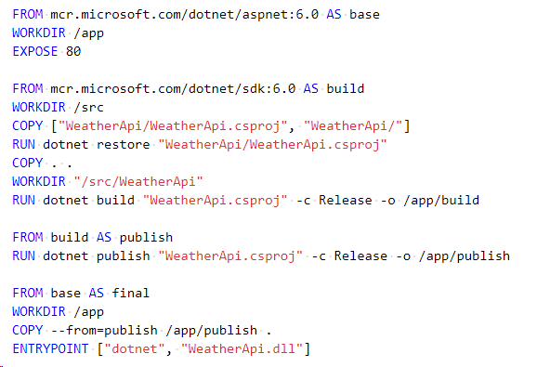
Dockerfile example

Slide 48
Building a Docker image
> docker image build [OPTIONS] PATH | URL | -
Common options:
--file (file path to Dockerfile; default is “Dockerfile” in current directory)
--tag (name and tag the image)
Reference:
https://docs.docker.com/engine/reference/commandline/image_build/

Slide 49
Pushing a Docker image
> docker image push [OPTIONS] NAME[:TAG]
Note:
Pushing a Docker image publishes it to a Docker image registry
Reference:
https://docs.docker.com/engine/reference/commandline/container_push/

Slide 50
Exporting/importing a Docker image
> docker image save –output ./image_name.tgz
> docker load –input ./image_name.tgz
Note:
Sometimes we don’t have access to a Docker image repository, but we still want to build an image and import it elsewhere. In this case we can export the image to a file and import that file to another Docker engine.
Reference:
https://docs.docker.com/engine/reference/commandline/image_save/
https://docs.docker.com/engine/reference/commandline/load/

Slide 51
DEMO Creating Docker images

Slide 52
Docker Compose

Slide 53
Docker Compose
Docker Compose allows us to pull Docker images, configure and run Docker containers all defined in one YAML file.
We can also use it to do the opposite: stop and remove all Docker containers and remove their Docker images.
With Docker Compose we can pull images from an image registry or build images locally.
This is very convenient when we have more than one container (for example when setting up development environments or deploying applications that require other resources).

Slide 54
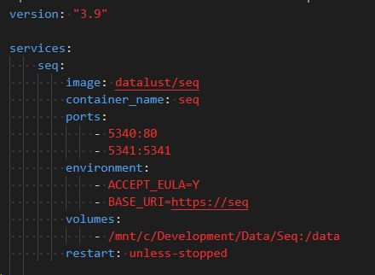
Docker Compose example

Slide 55
Docker Compose Up
> docker-compose up [options] [--scale SERVICE=NUM...] [SERVICE...]
Common options:
--detach (runs containers in dethatched mode)
--build (builds images)
--force-recreate (recreates running containers)
Reference:
https://docs.docker.com/compose/reference/up/

Slide 56
Docker Compose Down
> docker-compose [arguments] down [options]
Common options:
--rmi (removes referenced images after stopping containers)
--volumes (removes volumes)
Reference:
https://docs.docker.com/compose/reference/down/

Slide 57
Docker Volumes
Operating System
Docker
File System
Docker File System
/…/Directory 1
Docker Container
/…/Directory A
/…/Directory 2
/…/Directory B
/…/Directory 3
/…/Directory 4

Slide 58
Docker Networks
Docker
Network 2
Container
Network 1
Network 3
Container
Container
Container
Container

Slide 59
DEMO Working with Docker Compose

Slide 60
Docker Compose Demo
Docker
Web Browser
Weather UI
(Vue.js)
HTTP request
Weather API
(ASP.NET Web API)
Log entry
SEQ

Slide 61
Docker Engine API

Slide 62
Docker Engine API
Reference:
https://docs.docker.com/engine/api/

Slide 63
DEMO Working with Docker Engine API

Slide 64
Thank you!

